Slide 1
IT7099 CCNP Route For A Global Health Network
Student Name: Husain Ali
Student ID: 202202674
Supervisor Name: Dr.Ayman Alani

Slide 2
Introduction
The Global Health Network (GHN) operates across Bahrain, England, Luxembourg, and China, requiring a secure and resilient WAN to support HD medical consultations and critical internal services. The existing network lacked redundancy, encryption, and modern routing capabilities.

Slide 3
Aim and Requirements
Aim:
Design and implement a secure, robust WAN architecture enabling GHN branches in Bahrain, England, Luxembourg, and China to communicate reliably and support HD medical services.
Key requirement:
Build a fully functional enterprise grade WAN interconnecting the four GHN sites
Implement dynamic routing EIGRP, Named EIGRP, OSPFv2, OSPFv3, and MP-BGP
Deploy DMVPN Phase 3 with IPsec to provide encrypted and scalable
Integrate services DNS, FTP, Web, AAA, DHCP, and Email across the branches.

Slide 4









Technologies
Thunderbird
WinRadius
PuTTY
Notes:
Add slides as required
Development tools
Platform
Why chosen? (from a technical and managerial perspective)
Any Alternative technologies that could have been chosen

Slide 5
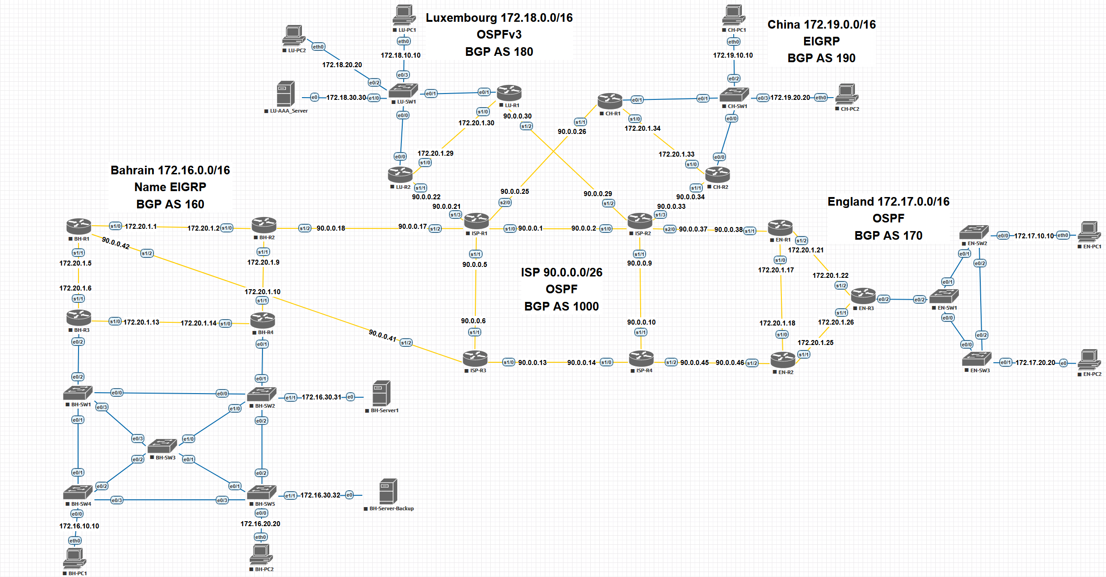
Design

Slide 6
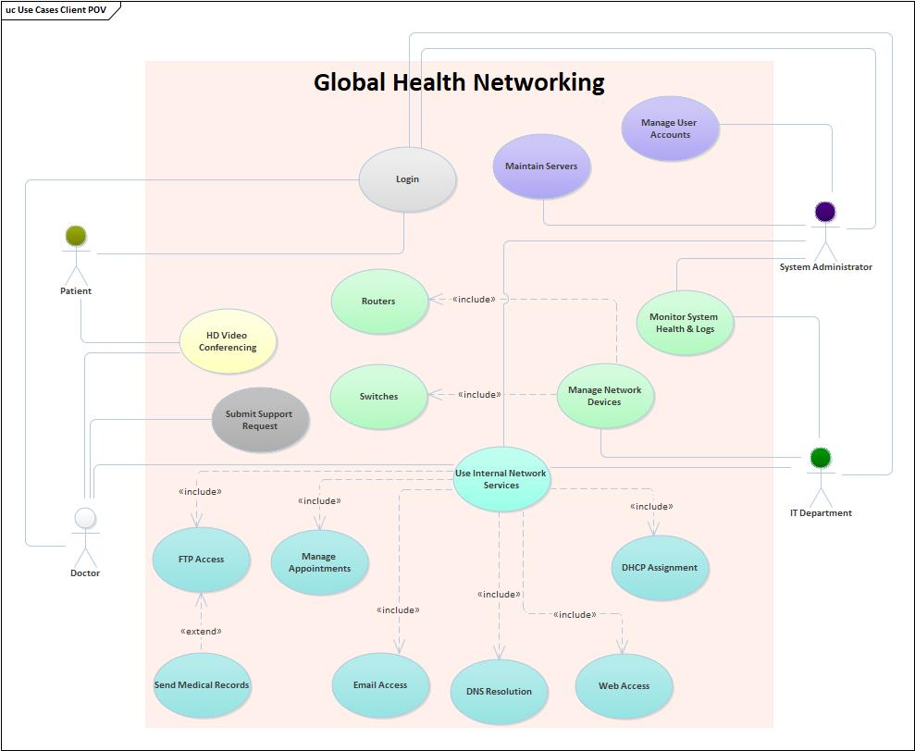
Use case diagram

Slide 7
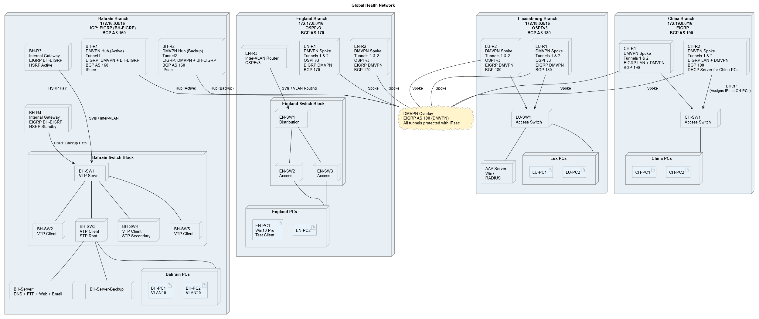
Deployment diagram

Slide 8
Features
1. Dynamic Multi-AS Routing
Fast convergence, load balancing, summarization
Stable inter-domain routing via MP-BGP
2. Secure DMVPN Phase 3
Spoke-to-spoke shortcuts
Reduced latency for HD consultation traffic
IPsec encryption for confidentiality and compliance
3. Redundancy & High Availability
Dual hubs
Redundant ISP paths
IGP failover mechanisms
4. LAN Segmentation & Security
VLAN isolation
L2 security to prevent switching attacks
5. Centralized Services
AAA Server
DNS, Web, FTP, Email, DHCP for internal operations
Notes:
List of main features (completed requirements)
You can use a diagram to represent the feature

Slide 9
Bahraini Perspectives & LESPI
Bahraini Perspectives
Supports Bahrain’s vision for modern digital healthcare
Enhances secure handling of patient data
Legal
Conforms to PDPL Law No. 30 (2018)
Ethical
Ensures integrity and confidentiality of sensitive medical data
Social
Reduces service disruption and improves global medical access
Professional
Implements ISO 27001-aligned security standards and best practices
Notes:
Legal:
The design complies with Bahrain PDPL Law No. 30 (2018) by ensuring confidentiality, controlled access, and encrypted data transmission.
Ethical:
Medical data is highly sensitive. Ethically, the network must prevent unauthorized access, data leakage, and misuse.
Social:
Reliable and secure connectivity improves continuity of care, especially for remote consultations. Reducing outages and latency directly impacts patient outcomes.
Professional:
The design follows enterprise best practices and aligns with ISO 27001 security principles, even in a simulated environment.

Slide 10
Challenges
Limited resources in the simulation environment
Windows Server 2019 instability in EVE-NG, replaced with 2012 R2
Windows 10 instability for AAA testing, replaced with Windows 7
High RAM and CPU demand of multi-site DMVPN and BGP topology
Notes:
Describes the technical/management challenges and the acquired skills

Slide 11
Future Work
Introduce MPLS Traffic Engineering for bandwidth optimization
Add QoS for prioritizing HD medical sessions
Deploy centralized SIEM for security monitoring
Move internal services toward high-availability clustering
Evaluate IPv6 migration for long-term scalability
Implement SD-WAN for application-aware routing decisions
Notes:
Future Work (How would you improve your project?)

Slide 12
Live Demo
Server services demonstration (DNS, DHCP, Web, FTP, Email)
VLAN segmentation and inter-VLAN routing using IGP per branch
Layer 2 security implementation
DMVPN Phase 3 and IPsec verification
AAA authentication demonstration
Note:
Due to EVE-NG resource limitations, the simulation environment may become unstable during the live demonstration. As a result, routers or servers may require restarting to continue the demo.
Notes:
Present your product
Have ready scenarios of demonstration and steps
Test these steps in sequence and concept
Describe what you do as you demonstrate

Slide 13
Q&A – By Panel
Notes:
Q&A - Clarity and confidence, Depth of Knowledge, Critical Thinking and Problem Solving, Relevance and Accuracy, Professionalism and composure
Sample Questions
Technical questions (why did you do it this way?)
Reflection (What would you do differently?)
Learning Experience (How did this course help you become work ready?)
Go back to the design, Explain this diagram , Explain this feature , Explain this code

